Slide 1
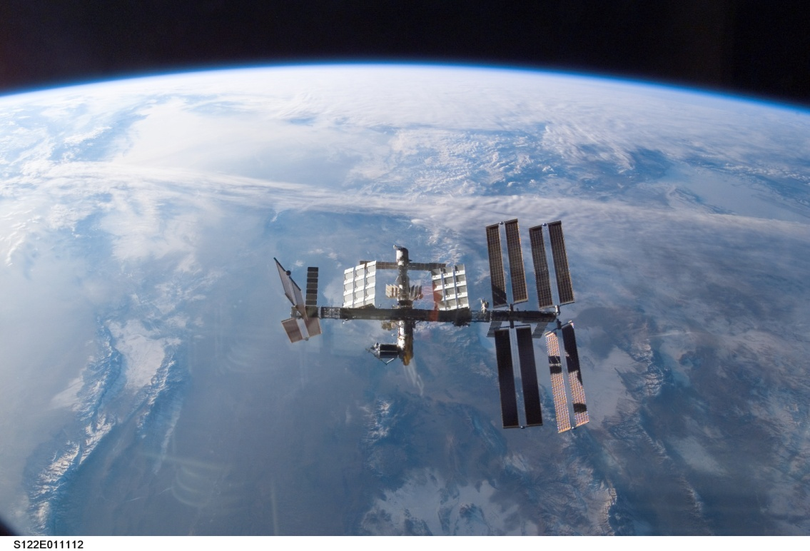
Gravitational Field Strength
This lesson will introduce you to the gravitational field strength of celestial object.
You will learn what factors affect the gravitational field strength as well as how to calculate it for various celestial objects.

Slide 2
Learning Goals
By the end of this lesson, you will be able to:
define gravitational field strength
determine the gravitational field strength
explain free fall
explain weightlessness

Slide 3
Success Criteria
Can I:
define gravitational field strength
determine the gravitational field strength at various points around the Earth and off the Earth
explain what is meant by the term free fall
explain why astronauts in the ISS are weightless

Slide 4
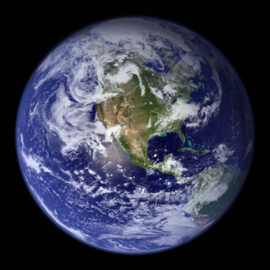
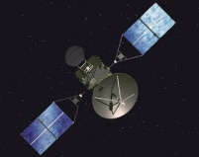
Gravitational Field Strength
grav field strength is a measure of the force of
gravity at a specific location
grav field strength changes with mass and distance
the symbol for grav field strength is g

Slide 5
Calculating Gravitational Field Strength
Since weight is the force of gravity on an object, we
can set the weight eqn equal to universal gravitation
This eqn tells us how to calculate the grav field strength

Slide 6
The grav field strength at the surface of the Earth is
9.8 N/kg
∴ g = 9.8 N/kg

Slide 7
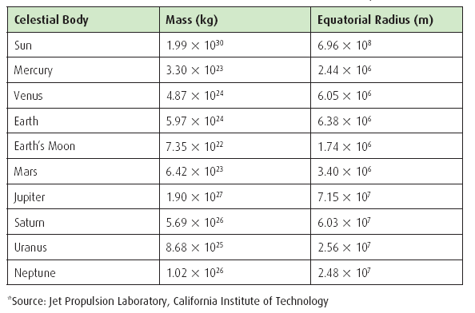

Slide 8
PRACTICE Problem
1. Calculate g on the Moon, Jupiter, and the Sun

Slide 9
PRACTICE Problem
2. Which statement below best describes grav field strength?
measures the amount of total gravity
measures the net gravity at a location
measures the strength of gravity at a location
measures the field of gravity
None of the above

Slide 10
PRACTICE Problem
3. What factor(s) affect the grav field strength?
mass
weight
Size (volume)
distance
Both a. and d.

Slide 11
PRACTICE Problem
4. What is/are the unit(s) of grav field strength?
N/m
N/kg
m/s²
N/s²
Both b. and c.

Slide 12

PRACTICE Problem
5. What is the grav field strength B-612, r = 2.0 and
m = 10,000 kg?
9.8 N/kg
1. 7 N/kg
1.7 x 10⁻³ N/kg
1.7 x 10⁻⁵ N/kg
1.7 x 10⁻⁷ N/kg

Slide 13
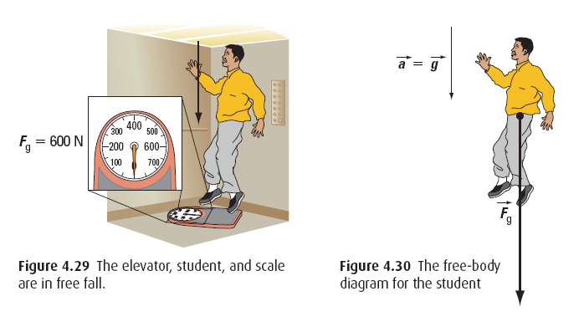
Free fall and Weightlessness
Objects that are falling near the Earth surface
are accelerating at 9.8 m/s²
We say that this object is in freefall

Slide 14
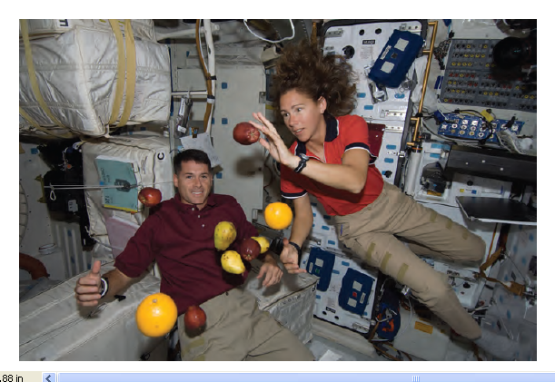

Slide 15
A person inside an elevator that is in freefall is accel
at g along with the elevator itself
As a result, the person would not experience a normal
force since they are falling at the same rate as the
elevator
The person is not truly weightless, but they are in a
weightless environment
In freefall F_{N} = 0, F_{g} ≠ 0
F_{N} is called the apparent weight

Slide 16
PRACTICE Problem
6. Which of the following is NOT an example of an object in freefall?
An astronaut in the ISS
A parachutist after opening their parachute
A baseball dropped from the CN tower
A student riding drop tower
Bullet fired horizontally from a gun

Slide 17
PRACTICE Problem
7. What force pair best describes freefall?
F_{N} = 0, F_{g} = 0
F_{N} ≠ 0, F_{g} ≠ 0
F_{N} ≠ 0, F_{g} = 0
F_{N} = 0, F_{g} ≠ 0
None of the above

Slide 18
PRACTICE Problem
8. What quantity would measure apparent weight?
F_{N}
F_{g}
F_{a}
F_{f}
None of the above

Slide 19
HOMEWORK
Read Section 4.1 pg 164 - 165
Questions 1 – 10 pg 167

